Slide 1




No Malaria
Malaria

Slide 2
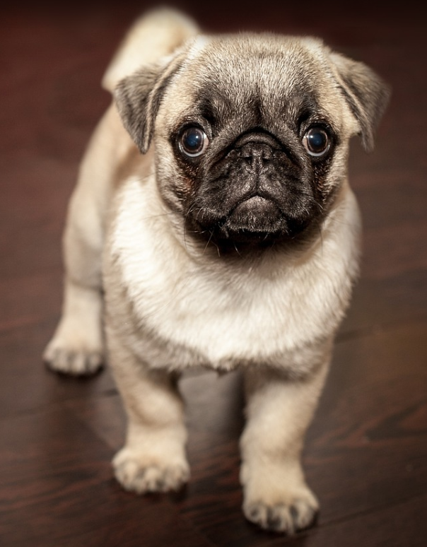
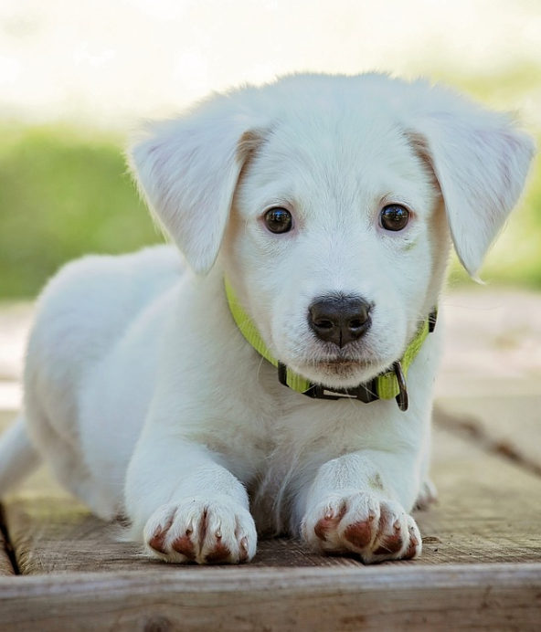

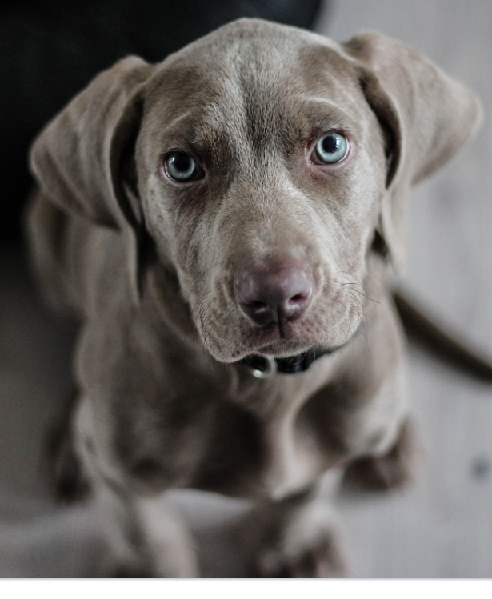
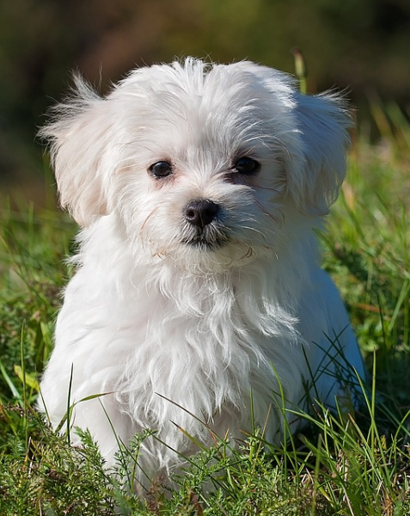
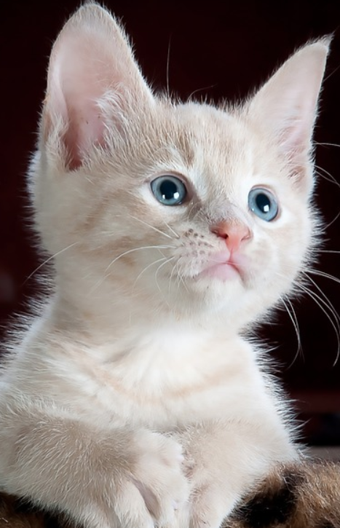
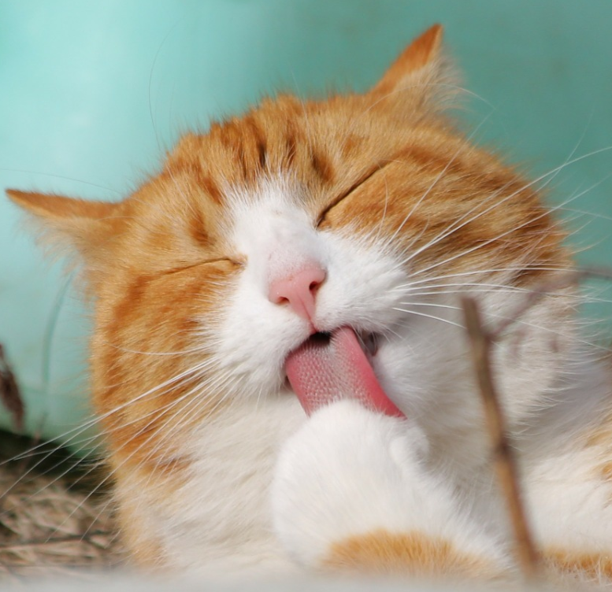
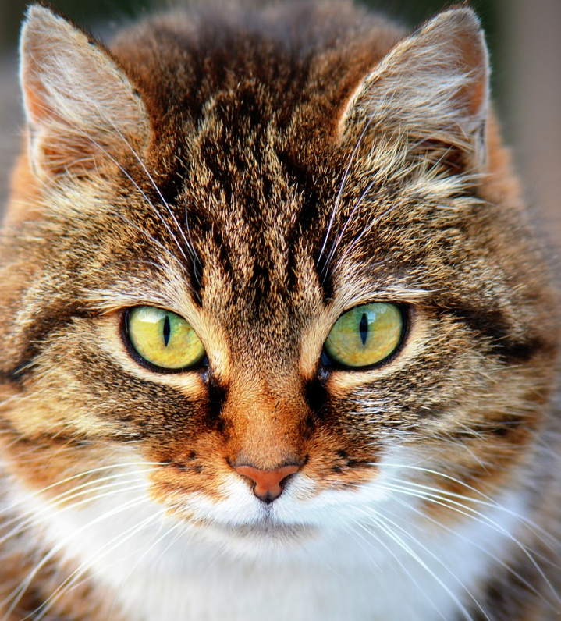
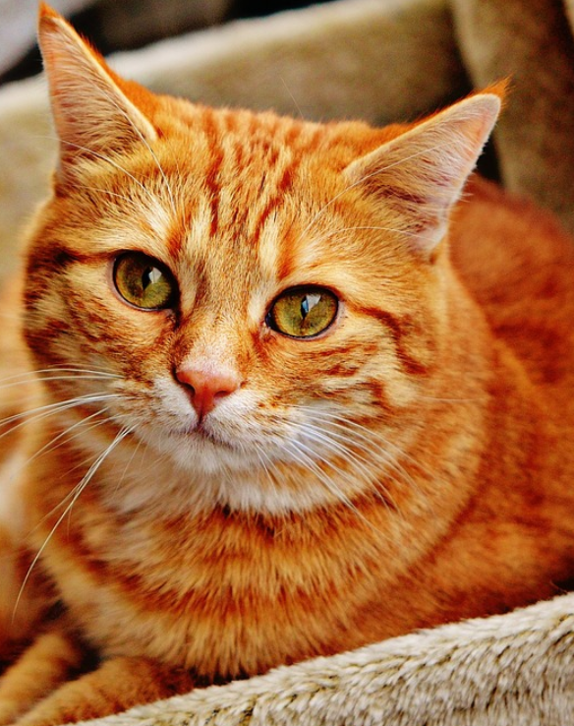
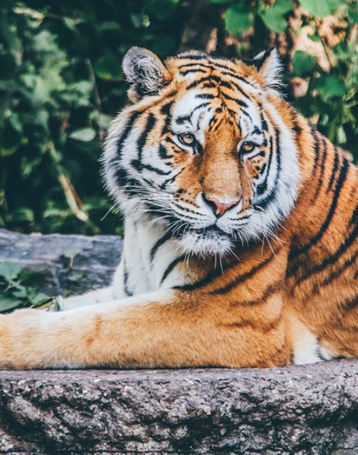
Real: dog
Pred: dog
Real: dog
Pred: dog
Real: dog
Pred: dog
Real: dog
Pred: dog
Real: dog
Pred: cat
Real: cat
Pred: cat
Real: cat
Pred: cat
Real: cat
Pred: cat
Real: cat
Pred: cat
Real: cat
Pred: cat

Slide 3
Predicted
False
True
False
Predicted false correctly
Predicted true wrongly
Actual
True
Pedicted false wrongly
Predicted true correctly

